Slide 1
QUANTUM MACHINE LEARNING (QML)
Prajwal A Nazre 01FE17BCS131
Under the guidance of
Dr. Satyadhyan Chickerur

Slide 2

AGENDA
Introduction
Motivation
Problem Statement
Literature Survey
Objectives
Proposed Framework
Implementation
Results
References

Slide 3
Introduction
Quantum computation means a theoretical paradigm based on the principles of quantum mechanics.
Quantum Information systems and Intelligent learning applications are some of the hot topics for research today.
Quantum computers use Qubits as their fundamental unit.
A Qubit is equivalent to traditional computer bit and differs significantly from it.

Slide 4
Motivation
Quantum Computing is an emerging field today. It is at an infantry stage and knowing about it would prove to be very fruitful in the future
It is interesting how this concept can be applied to Machine Learning where computations take a long time.
If a reliable quantum computer has been built, machine learning can accelerate from solving the problems for days and months within a matter of seconds.

Slide 5
Problem Statement
Implementing machine learning algorithms on a Quantum Computer simulator and comparing with traditional machine learning algorithms.

Slide 6
Literature survey
TensorFlow Quantum: A Software Framework for Quantum Machine Learning (6 Mar 2020)
In this paper, they show how to use TFQ to solve advanced quantum learning tasks like meta-learning, Hamiltonian learning, and sampled thermal states in this article.
Unsupervised Machine Learning on a Hybrid Quantum Computer (December 18, 2017)
In this paper, we address the problem how to represent a classical data distribution in a quantum system. The proposed method is to learn quantum Hamiltonian that is such that its ground state approximates the given classical distribution.

Slide 7
Literature survey
Quantum Machine Learning: A Classical Perspective (17 January 2018)
The shortcomings of quantum algorithms, how they relate to their best classical counterparts, and why quantum tools are supposed to have advantages for learning problems are all discussed in this article.
An Introduction to Quantum Machine Learning (September 11, 2014)
Different approaches to quantum machine learning are presented in this paper. Many scholars attempt to find quantum algorithms that replace conventional machine learning to solve a problem and demonstrate how a complete change can be achieved.

Slide 8
Objectives
Study and Understand Machine Learning on Quantum Computing.
Understand the different Quantum Computer simulators.
To design quantum trainable circuits for machine learning.
Implementing machine learning on quantum simulators .
Analyse the performance between classical computer and quantum computers.

Slide 9
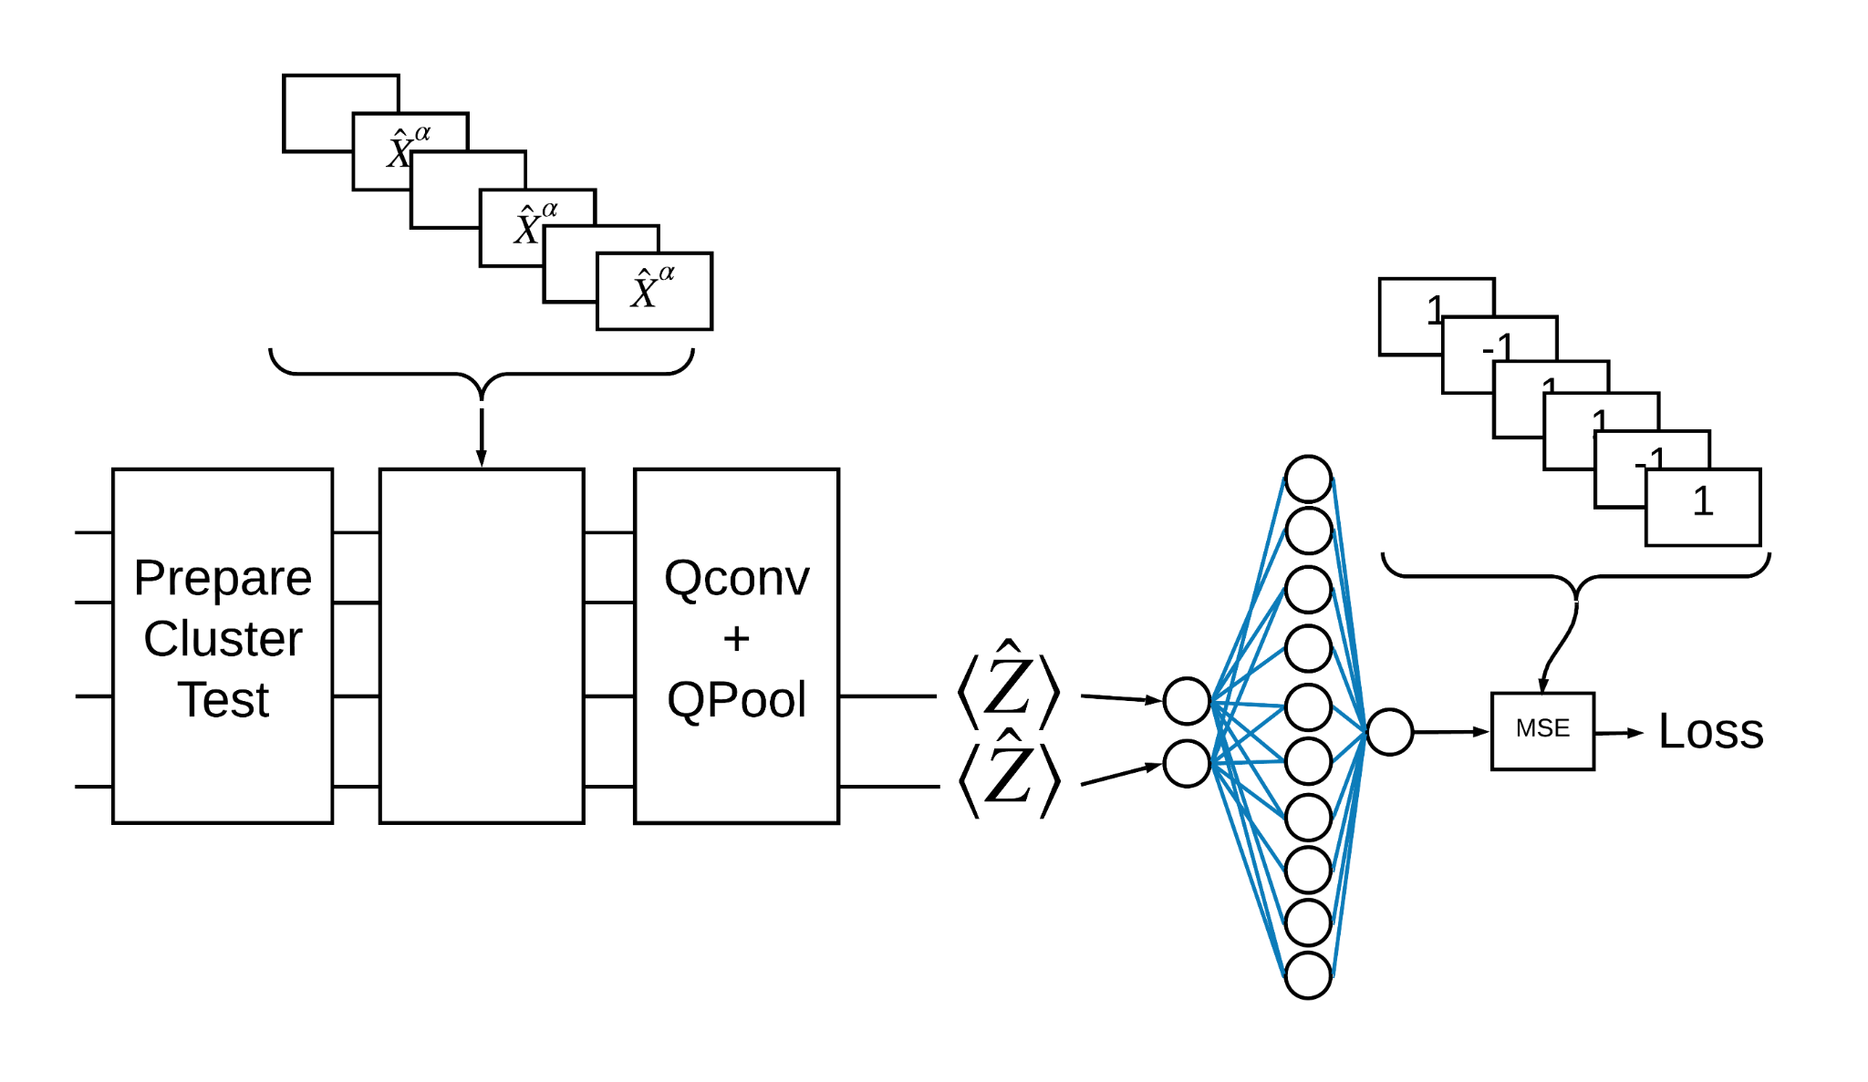
Quantum Machine learning model

Slide 10
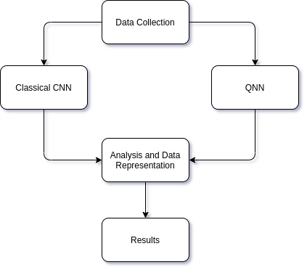
Proposed Framework

Slide 11
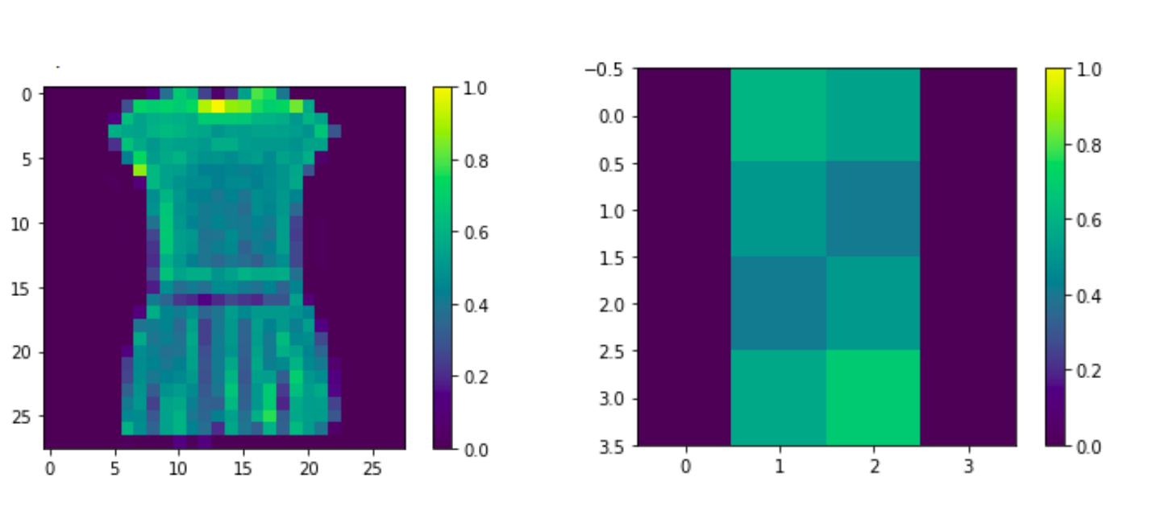
Loading Data Set

Slide 12
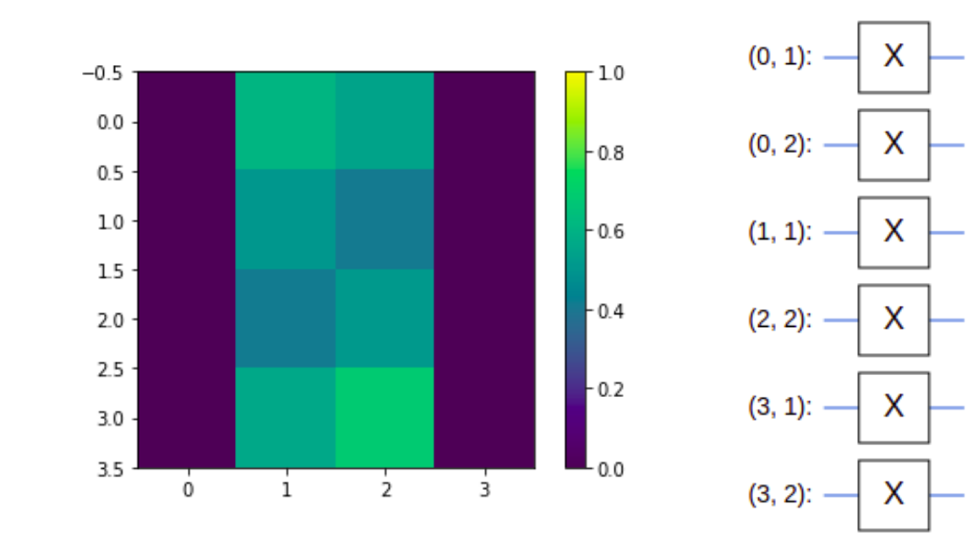
Equivalent Gates for Image

Slide 13
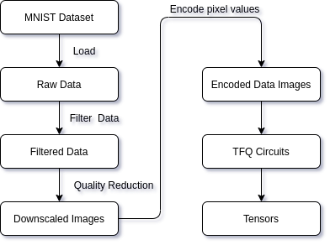
Data Transfortmations

Slide 14
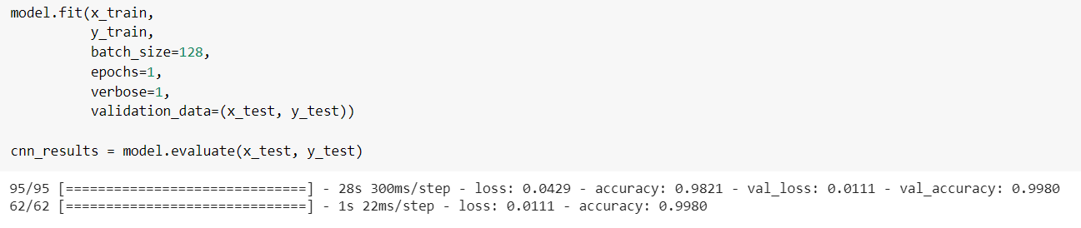
Training and Validation of CNN model

Slide 15
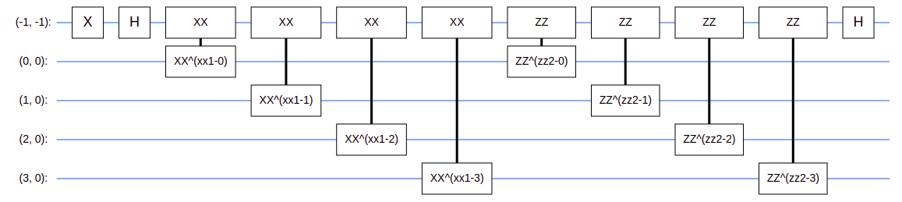
Quantum Circuit (Tensorflow-Quantum & Cirq)

Slide 16
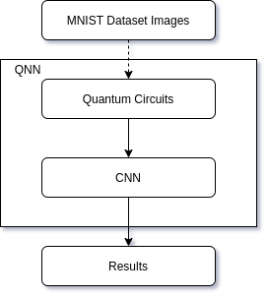
QNN Structure

Slide 17
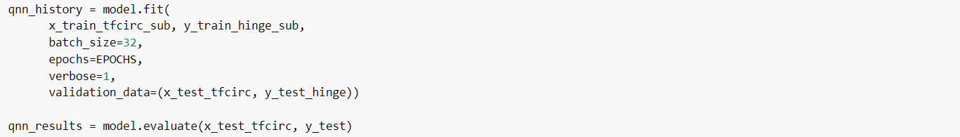
Training and Validation(Tensorflow-Quantum)

Slide 18
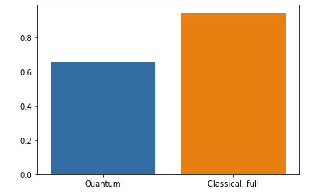
Comparing tensorflow-quantum model with CNN at 100% data

Slide 19
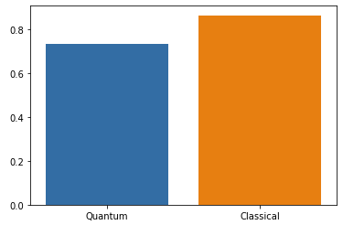
Comparing tensorflow-quantum model with CNN at 50% data

Slide 20
References
[1] Michael Broughton, Guillaume Verdon, Trevor McCourt, Antonio J. Martinez,“TensorFlow Quantum: A Software Framework for Quantum Machine Learning”, arXiv:2003.02989 [quant-ph] (6 Mar 2020)
[2] Carlo Ciliberto, Mark Herbster, Alessandro Davide Ialongo, Massimiliano Pontil, Andrea Rocchetto, “Quantum Machine Learning: A Classical Perspective”, DOI: 10.1098/rspa.2017.0551 (17 January 2018)
[3] M. Schuld, I. Sinayskiy, F. Petruccione, “An Introduction to Quantum Machine Learning”,
arXiv:1409.3097 [quant-ph] (September 11, 2014)
[4] J. S. Otterbach, R. Manenti, N. Alidoust, A. Bestwick, M. Block, B. Bloom, “Unsupervised Machine Learning on a Hybrid Quantum Computer”, arXiv:1712.05771 [quant-ph] (December 18, 2017)

Slide 21
THANK YOU

